Slide 1
APIs
George Wyner
January 28, 2016

Slide 2
Agenda
What is an API?
How do developers discover, understand, and use APIs to build applications
How to use an API without writing code and how useful will that be?

Slide 3
A Little Background:
Modularity
Build complex systems from re-usable parts (“modules”)
Mashups
Programming Libraries
Frameworks (Rails, Django, Cocoa, .NET, MEAN…).

Slide 4
Modules and Innovation
Recombine to innovate
Start on third base (or the 50 yard line)
Ecosystems and communities

Slide 5
API = “Application Programming Interface”
the interface made available to programmers (and their programs) wishing to interact with an application (i.e. an information system)
the documentation describing such an interface and how to use it
An API is a Lego box full of modules ready to fuel innovation

Slide 6
Examples
Salesforce
Facebook
Twitter
iOS, watchOS, OS X, Windows
.NET
Watson
Google Apps
Amazon Web Services
Trello, Slack, and on and on…

Slide 7
Why should you learn about APIs?
Billions of API calls per month on Google, Twitter, Facebook, Netflix, etc.
Zynga depends on Facebook’s APIs → Facebook gets a 5 year revenue sharing deal with Zynga
Force.com

Slide 8

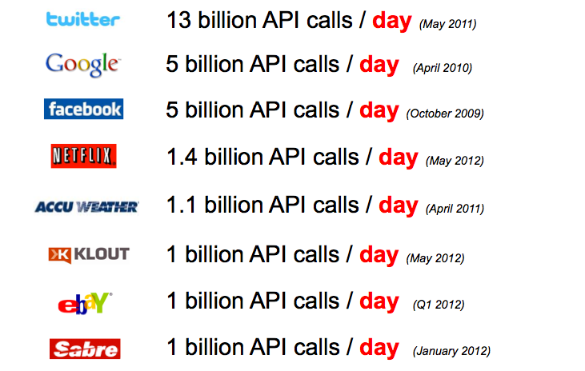
API Billionaires Club as of 2012

Slide 9
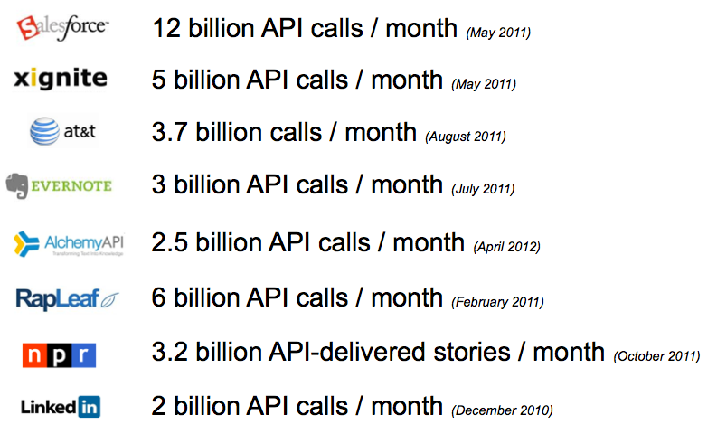
API Billionaires Club as of 2012, p. 2

Slide 10
Describing An API
A list (menu) of functions
What do these functions do?
Their inputs: parameters
Their outputs: return values
How to request service
How to use all these services together

Slide 11
How to Request Services
Within a program
  call a function (may need to import or link to modules)
From the operating system
  use special CPU instructions to communicate with OS
  buried deep inside an interpreter or compiler
Other programs on the computer
  the operating system makes this possible
  e.g. Microsoft's DLL and Apple's Apple Events
Other programs on other computers
    good question!

Slide 12
Accessing APIS: RESTful Web Services
Representational State Transfer (REST)
  Originally described by Roy Fielding
Instead of new specialized tech, use simple HTTP
  URL tells you which resource you want
  Resource = document, record, etc.
  HTTP method tells you what to do:
PUT | Create new resource
POST | Update existing resource
GET | Read resource
DELETE | Delete resource

Slide 13


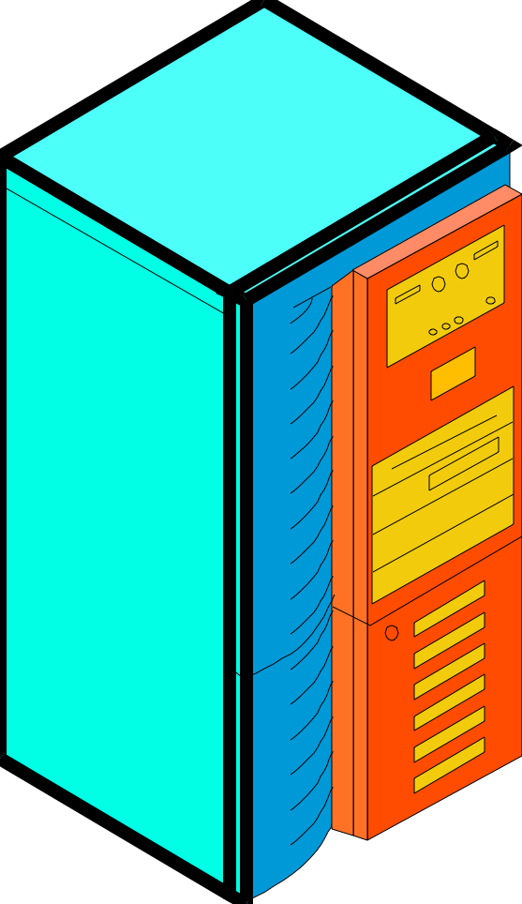

Request and Response Use HTTP
Webserver
Application
Browser
1.
HTTP Request
2.
HTTP Response
Webserver
Client PC
HTML Document
Notes:
In HTTP, the browser sends an HTTP request.
The webserver application program sends back an HTTP response message.

Slide 14
Example of HTTP Request Message
GET /panko/home.htm HTTP/1.1
Host: voyager.cba.hawaii.edu

Slide 15
Example of HTTP Response Message
HTTP/1.1 200 OK
Date: Tuesday, 20-JAN-2004 18:32:15 GMT
Server: name of server software
MIME-version: 1.0
Content-type: text/plain
File to be downloaded

Slide 16
Let’s kick the tires of some APIs and take one out for a spin!

Slide 17
Fire up the engine
Manually using some APIs (Paw)
Building the Singing Translator
User friendly APIs (Zapier, IFTTT)
Resources
  http://www.programmableweb.com
  http://api.wikia.com/wiki/LyricWiki_API/Support_Matrix
  https://ifttt.com
  https://zapier.com/app/dashboard

Slide 18
How do we know what is out there, understand it, and connect with it?

Slide 19
Discovery and Curation
Social media and the modern web can help use share and discover and curate,
but how do we describe these capabilities and figure out how to use them and what tech is needed to connect everything
Describe and learn: old story: functions. plus examples. screencasts. standard documentation. automatic documentation.
Connect… used to be complicated but it turns out the same web tech we use to collaborate and learn can also connect our programs and our data.

